Slide 1
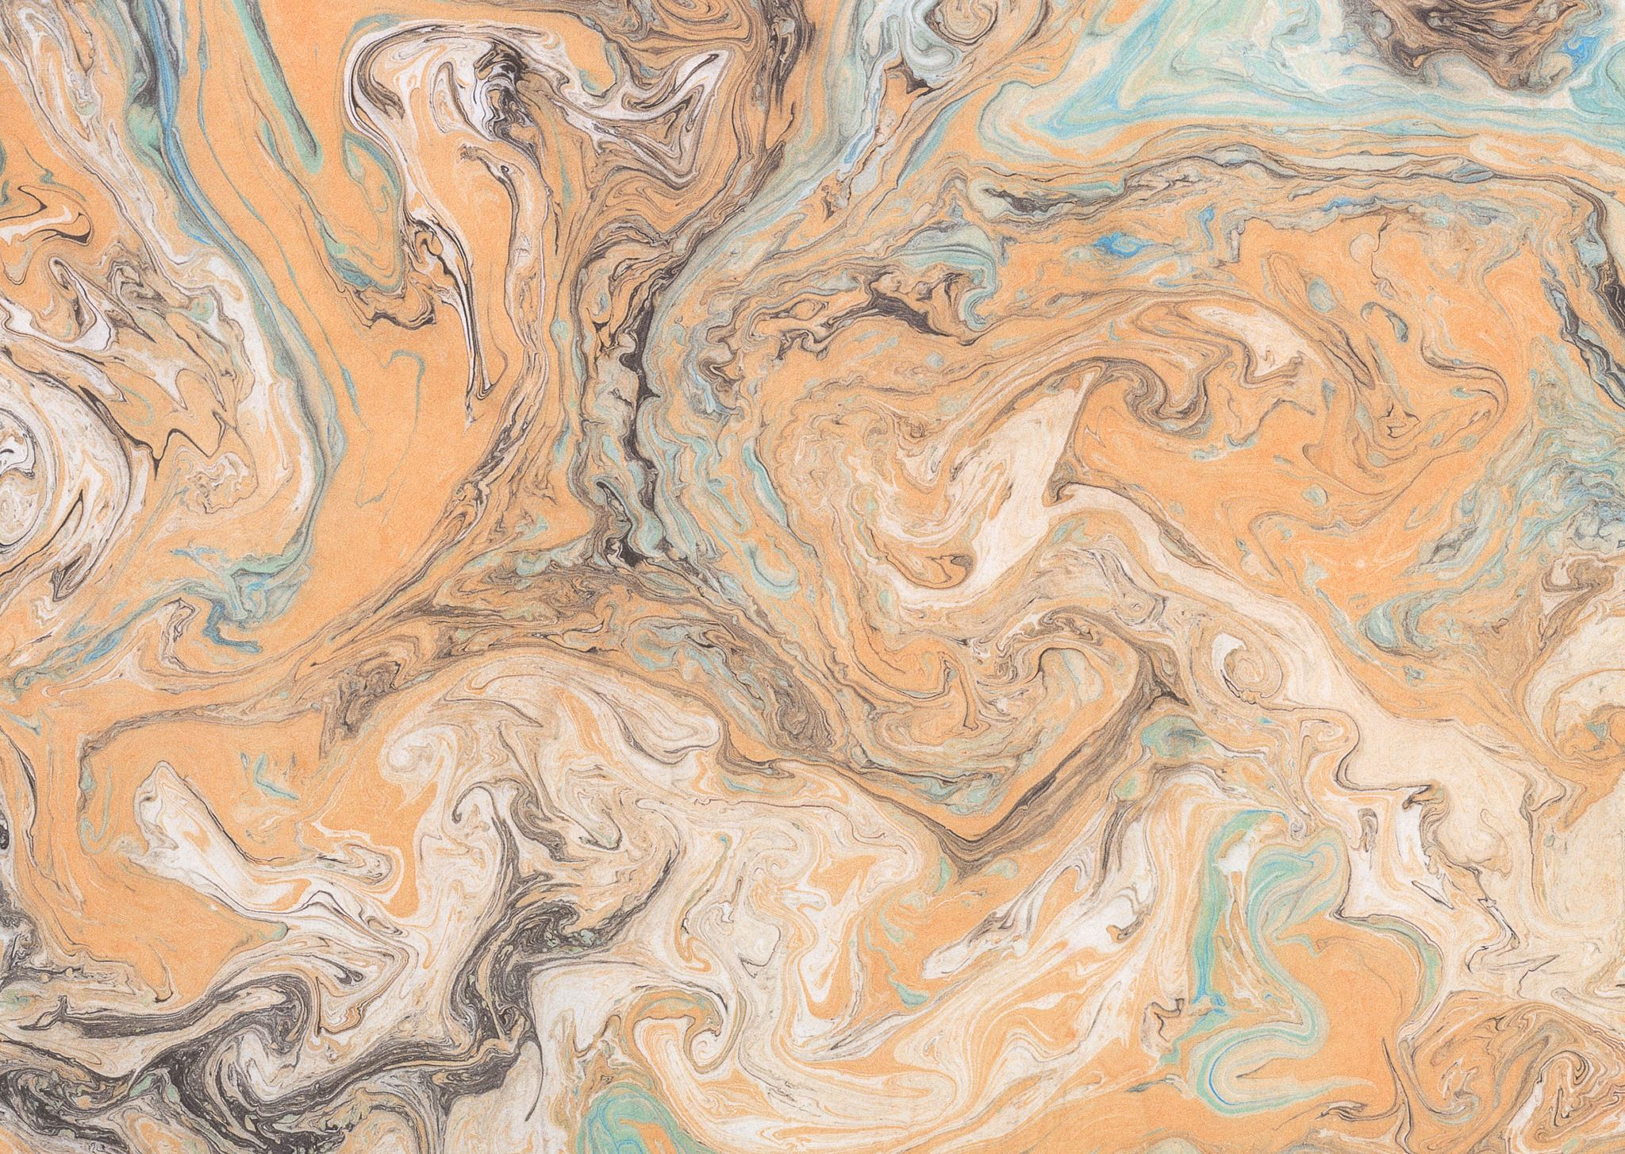

Midterm Report Novelty Detection in Martian Geology Images Using Advanced High-Dimensional Tensor Decomposition Methods
Anthony Chan
June 8, 2024
Notes:
Good [morning/afternoon/evening], everyone. Thank you for joining my presentation today. My name is [Your Name], and I will be discussing an approach to detecting novelty in Martian geology. The focus is on using advanced high-dimensional tensor decomposition methods to preprocess multispectral images, aiming to enhance the detection of novel geological features on the surface of Mars.

Slide 2
Sponsor Proposal Topic
Machine Learning/Computer Vision Applied to Signal Analysis to automatically predict signal degradation
Sponsor: Sandia National Laboratiries

Slide 3
Project Focus
Novelty Detection in Martian Geology Images Using Advanced High-Dimensional Tensor Decomposition Methods
Novelty detection utilizes similar techniques as anomaly detection

Slide 4
Introduction
Importance of identifying novel geological features on Mars
Challenge: High-dimensional nature of multispectral images
Solution: Advanced high-dimensional tensor decomposition methods
Notes:
Exploration missions to Mars, like those involving the Curiosity rover, generate a large amount of multispectral image data. Identifying novel geological features within these images is crucial for further scientific analysis. However, the high-dimensional nature of these images poses a significant challenge for traditional analysis methods. To address this, we propose using advanced high-dimensional tensor decomposition methods, which can effectively handle complex data and aid in the identification of novel features.

Slide 5
Problem
Prior studies conducted novelty detection using lower dimensional decomposition methods such as PCA, RX, autoencoder neural networks and generative adversarial networks
This study will use higher dimensional decomposition methods such as CP and tucker decomposition prior to novelty detection training.
Notes:
Previous research has explored various methods for novelty detection, such as PCA, RX, autoencoder neural networks, and generative adversarial networks. While these methods have been effective to some extent, they often struggle with the high-dimensional nature of multispectral images. Our study aims to improve upon these methods by utilizing higher-dimensional decomposition techniques like CP and Tucker decomposition before conducting novelty detection training. This approach leverages the strengths of tensor decomposition to better handle complex, high-dimensional data.

Slide 6
Data collection and pre-processing
Load images associate with typical or novel labels
Each image set contains six 64x64 grayscale image
11,114 sets of non-novel images = total of 66,684 images
430 novel images sets = total of 2580 images
Novel images and its type are identified by an expert.
Several types of novel images
DRT spot
Dump pile
Broken rock
Drill hole
Meteorite
Vein
Float rock
Bedrock
Notes:
For our study, we collected a dataset of multispectral images. This is provided by a prior study. Each image is labeled as either typical or novel and each novel image is identified by experts from a prior study based on their type, such as DRT spots, dump piles, broken rocks, drill holes, meteorites, veins, float rocks, and bedrock. This comprehensive dataset allows us to train and evaluate our novelty detection models effectively.

Slide 7
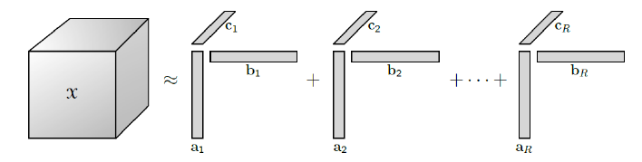
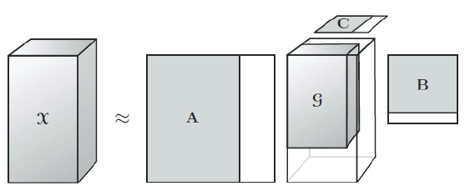
Tensor decomposition
CP decomposition
Tucker decomposition
Functional PCA
Notes:
We utilize several tensor decomposition techniques to preprocess our high-dimensional image data. CP decomposition breaks down tensors into a sum of rank-one components, making it easier to analyze complex datasets. Tucker decomposition, on the other hand, decomposes tensors into a core tensor and factor matrices, providing a more flexible representation of the data. Additionally, if there is time, we can employ Functional PCA, which reduces dimensionality while preserving essential features. These decomposition methods enable us to extract meaningful features from the images, facilitating more effective novelty detection.

Slide 8
Model selection and training
One-Class SVM
Neural networks
Decision trees
Random forests
Notes:
After preprocessing the images using tensor decomposition, we move on to model selection and training. We will experiment with various machine learning models, including Support Vector Machines (SVM), neural networks, decision trees, and random forests. Each model offers unique strengths, and we aim to identify the one that provides the best balance between detection accuracy and computational efficiency.

Slide 9
Model evaluation and threshold selection
Training / Test / Validation split 80/10/10
Evaluate detection accuracy on the test sets
Select the top performing decomposition rank that optimizes prediction accuracy with run time performance.
Notes:
To evaluate our models, we split the data into training, test, and validation sets in an 80/10/10 ratio. Our goal is to identify the top-performing decomposition rank that optimizes both prediction accuracy and runtime performance. This ensures that our approach is not only effective but also practical for real-world applications."

Slide 10
Model deployment and recommendations
Document results and recommendations for further research
Future Work: Application to other datasets, further optimization
Other image sets
Eg. CCTV cameras for anomaly detection, temperature sensor images, etc.
Signal data sets for anomaly detection
Notes:
Once we have identified the best model and decomposition method, we document our results and prepare them for publication. Additionally, we provide recommendations for further research, which include applying our approach to other datasets, such as CCTV camera feeds for anomaly detection or temperature sensor images.

Slide 11
Progress- Accomplished so far
Data reading and organize for training
Performed preliminary CP and Tucker decomposition
Applied One-class SVM to decomposed tensors
Notes:
Once we have identified the best model and decomposition method, we document our results and prepare them for publication. Additionally, we provide recommendations for further research, which include applying our approach to other datasets, such as CCTV camera feeds for anomaly detection or temperature sensor images.

Slide 12
Conclusion
Summary: Combined CP and Tucker decomposition with novelty detection
Benefits: Enhanced detection of novel geological formations
Future Work: Application to other datasets, further optimization
Other image sets
Eg. CCTV cameras for anomaly detection, temperature sensor images, etc.
Signal data sets for anomaly detection
Notes:
In conclusion, our study combines CP and Tucker decomposition with advanced novelty detection techniques to significantly enhance the detection of novel geological formations on Mars. This approach not only improves accuracy but also provides a practical solution for handling high-dimensional image data.

Slide 13
Prior studies
Comparison of novelty detection methods for multispectral images in rover-based planetary exploration missions
Kerner, Wagstaff, Bue, Wellington, Jacob, Horton, Bell, Kwan, Amor
Principal Component Analysis (PCA): Uses reconstruction error from principal subspace as a novelty score.
Kwak (2008), Chandola et al. (2009), Toivola et al. (2010), Wagstaff et al. (2013), Xiao et al. (2013), Jablonski et al. (2015).
Autoencoders: Neural networks trained to minimize reconstruction error for typical examples; score novelty using reconstruction error
Hinton and Salakhutdinov (2006), Japkowicz et al. (1995), Thompson et al. (2002), Williams et al. (2002), Manevitz and Yousef (2007), Xiong and Zuo (2016), Richter and Roy (2017), Zhou and Paaenroth (2017), Kerner et al. (2019).
Variational Autoencoders & GANs: Proposed for complex data relationships and novelty detection.
An and Cho (2015), Park et al. (2018), Goodfellow et al. (2014), Antipov et al. (2017), Dong et al. (2018), Schlegl et al. (2017), Akcay et al. (2018), Zenati et al. (2018b).
Notes:
The following are the relevant prior studies. Thank you for your time.

